Slide 1





Folder 1
6419
0653
2314
8092
0456

Slide 2


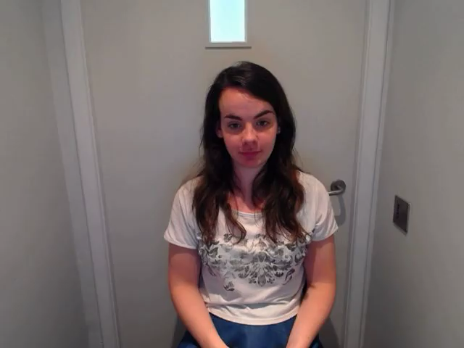


Folder 2
7698
8552
6430
3602
9293

Slide 3





Folder 3
4675
2473
7219
5538
0438

Slide 4





Folder 4
6478
4897
6908
2435
3856

